Slide 1






CAPSTONE TABLEAU
ALFIN SAM MATHEW
ENROLL.: EN12024078062
BATCH : DA132S13

Slide 2



Introduction
In an effort to address declining performance in its credit card business, a North American bank has initiated a comprehensive customer churn analysis. This analysis aims to delve into customer attrition patterns, offering insights to mitigate the bank's customer loss rates.

Slide 3


Objective
Analyze the bank's customer data
Identify factors contributing to
Enabling the bank to implement targeted measures aimed at retaining valuable customers and revitalizing its credit card business.

Slide 4

Dataset
The dataset for this customer churn analysis project consists of comprehensive information about the bank's North American credit card customers. It encompasses demographic details, financial profiles, transaction histories, and customer interactions with the bank's credit card services. Of particular importance is the inclusion of a churn indicator, allowing us to classify customers as either active or churned based on their credit card usage status. This dataset serves as the foundation for our analysis, as we aim to uncover meaningful insights that will guide the bank in implementing measures to reduce customer attrition and enhance the performance of its credit card business.

Slide 5

Analysis >

Slide 6
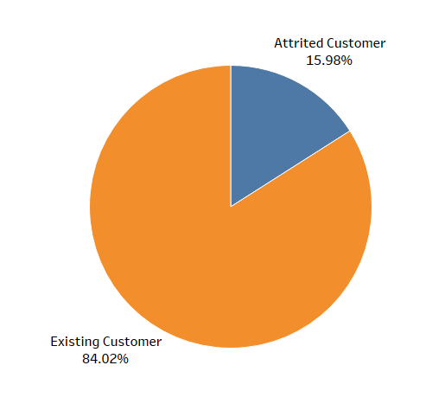


Percentage wise attrited and existing customers.
There are 84% of Existing customer and 16% percent of Attrited customers.

Slide 7
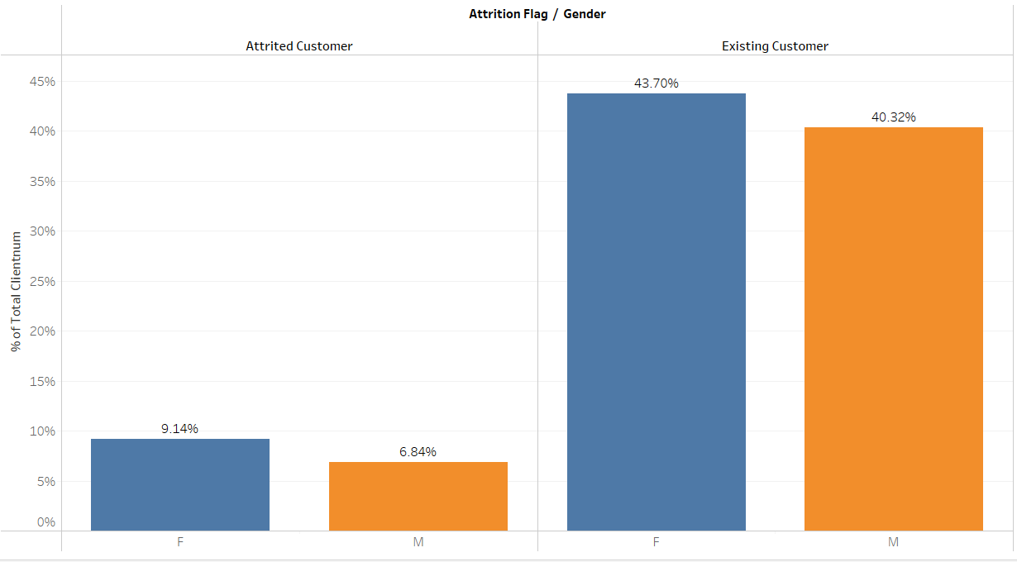
There are 84% of Existing customer and 16% percent of Attrited customers.
In both Attrited customers and Existing customers, majority is females.

Slide 8
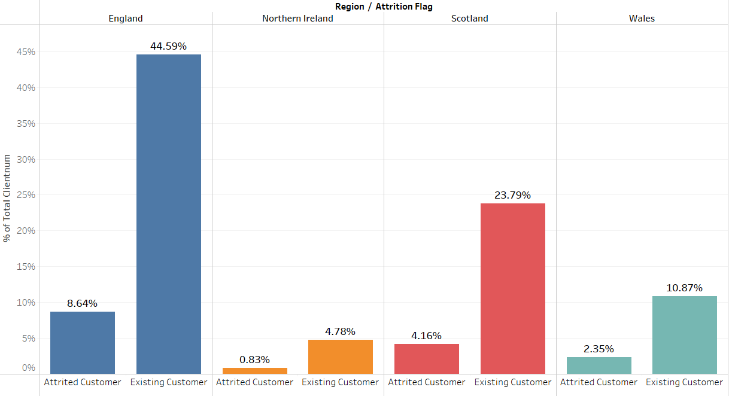
Region-wise percentage of attrited and existing customers
Both Attrited and Existing customer is high in England and low in Wales.

Slide 9

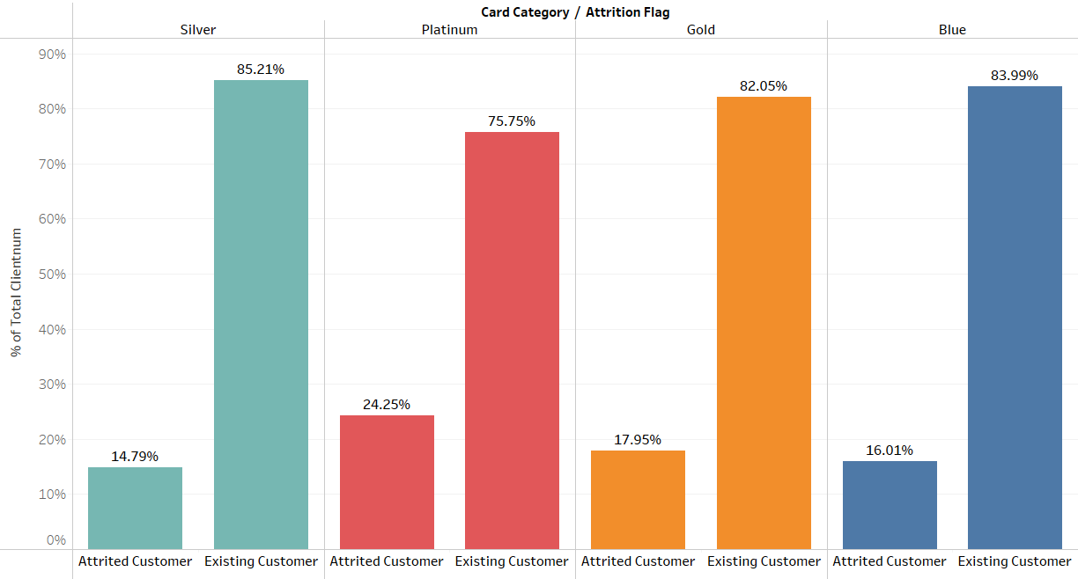

Percentage of attrited and existing customers for each card category
Silver category has the most number of Existing customers and Platinum has the most number of Attrited customers.

Slide 10
Percentage of attrited and existing customers for each income category
The majority of existing and attrited customers have income less than $40k.

Slide 11
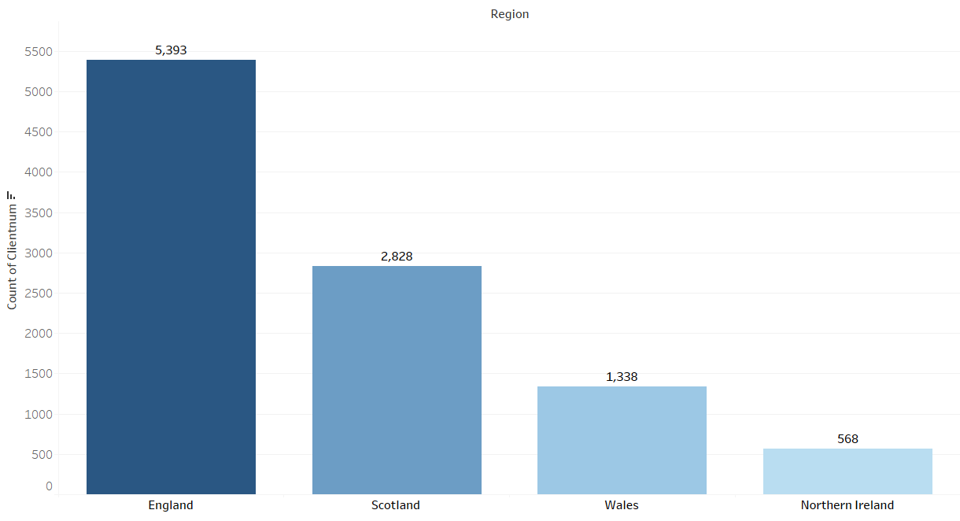
Region-wise count of customers
Highest customers are in England followed by Scotland, Wales and Northern Ireland.

Slide 12
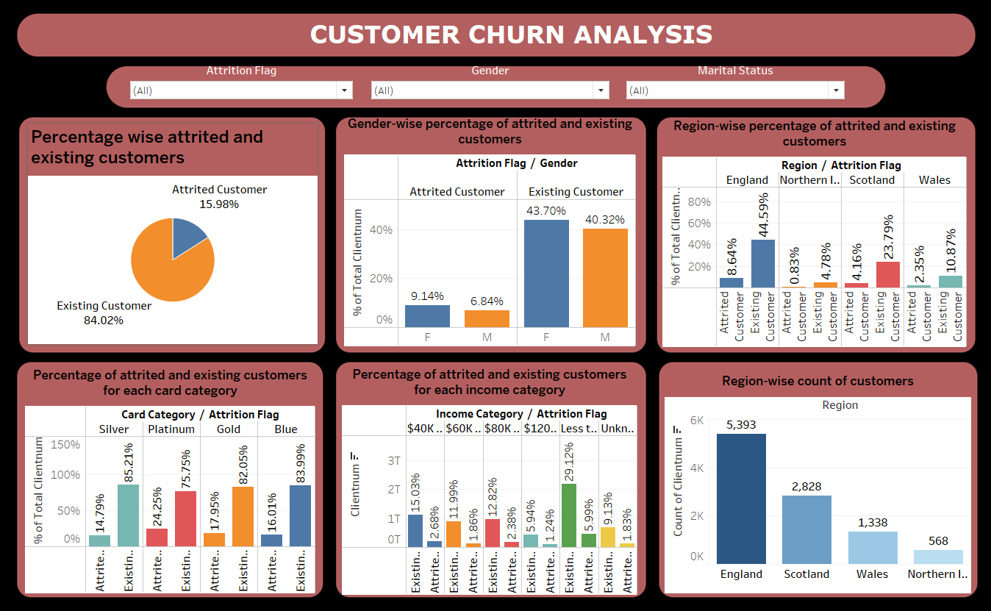
Customer Churn Analysis - Dashboard

Slide 13
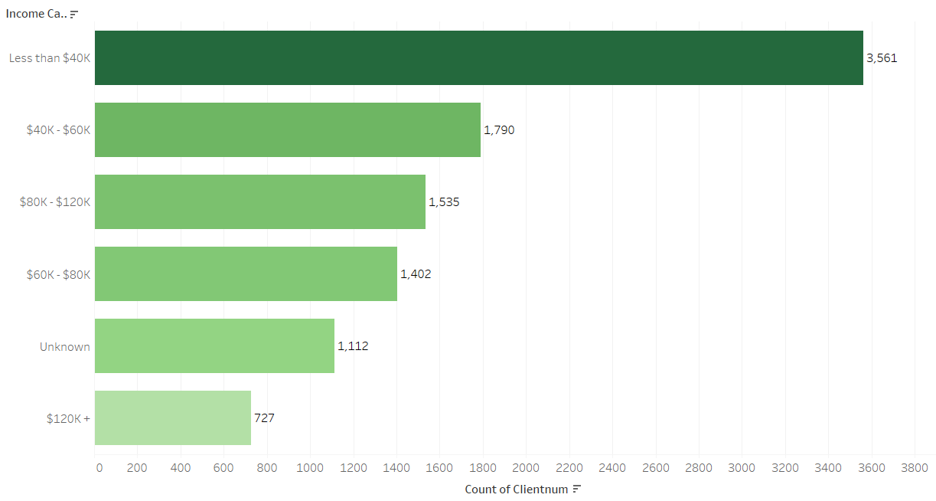
Income Category wise count of customers
Most of the customers are below $40k income category.

Slide 14
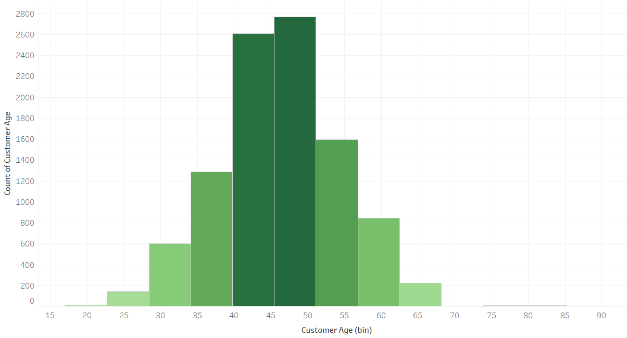
Age Distribution of customers
The age distribution of attrited customers indicates that a significant number of attrited customers are in the age group between 40 and 50. This suggests that customers in their 40s and 50s are more likely to churn.

Slide 15
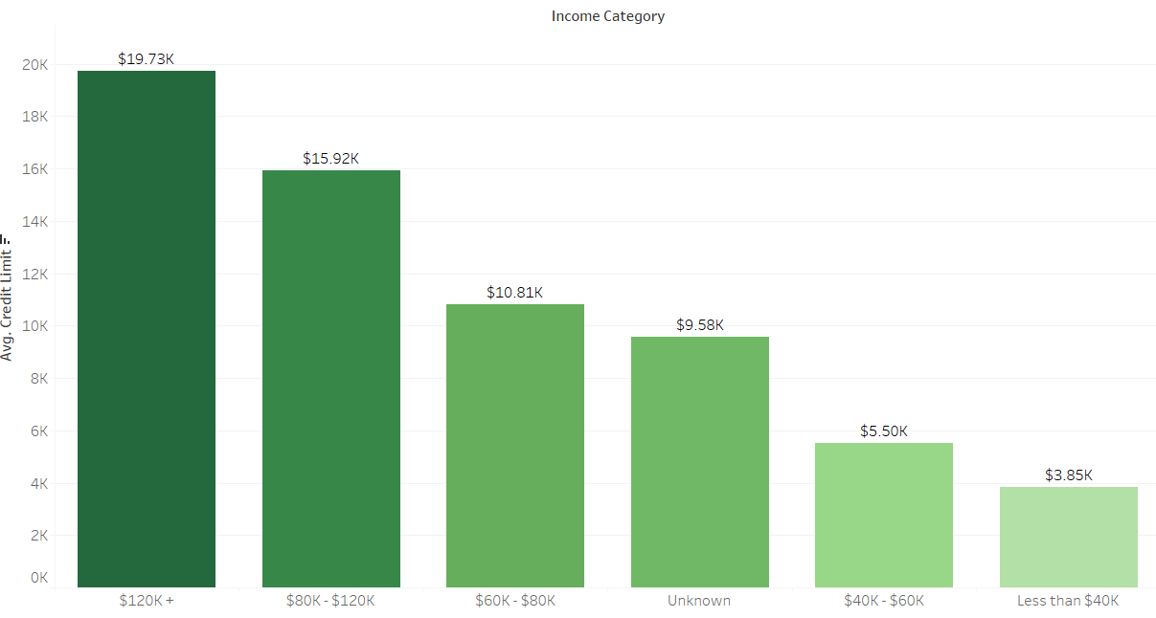
Income category vs Credit limit
Customers with higher incomes generally have higher credit limits. It also reveals that customers in the "$120K +" income category have the highest credit limits on average.

Slide 16
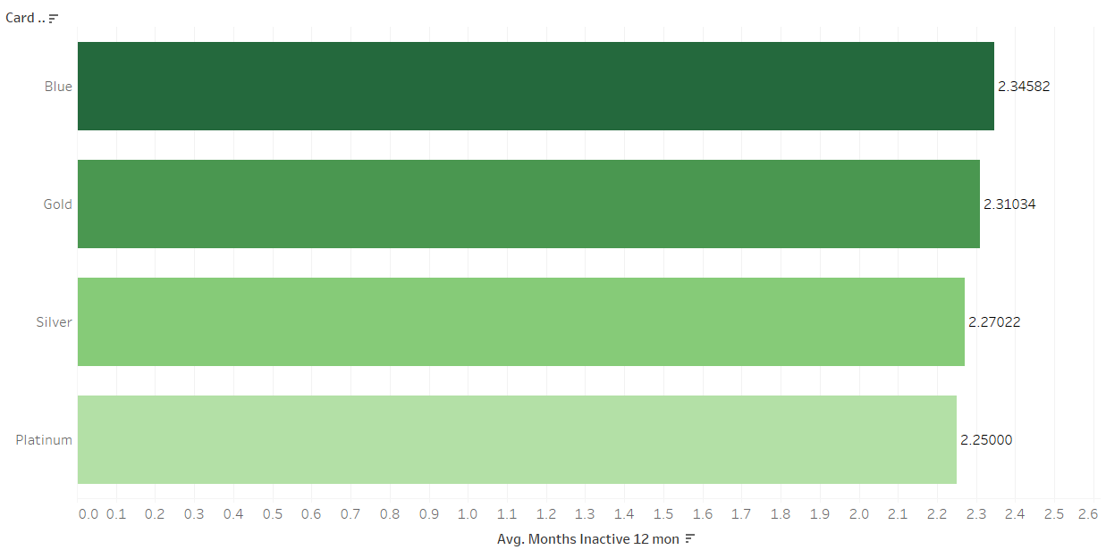
Inactive Month Analysis
The analysis of inactive months by card category reveals that Platinum cardholders have, on average, fewer inactive months compared to other card categories. This suggests that Platinum cardholders are more engaged with their cards, possibly due to exclusive benefits or features.

Slide 17
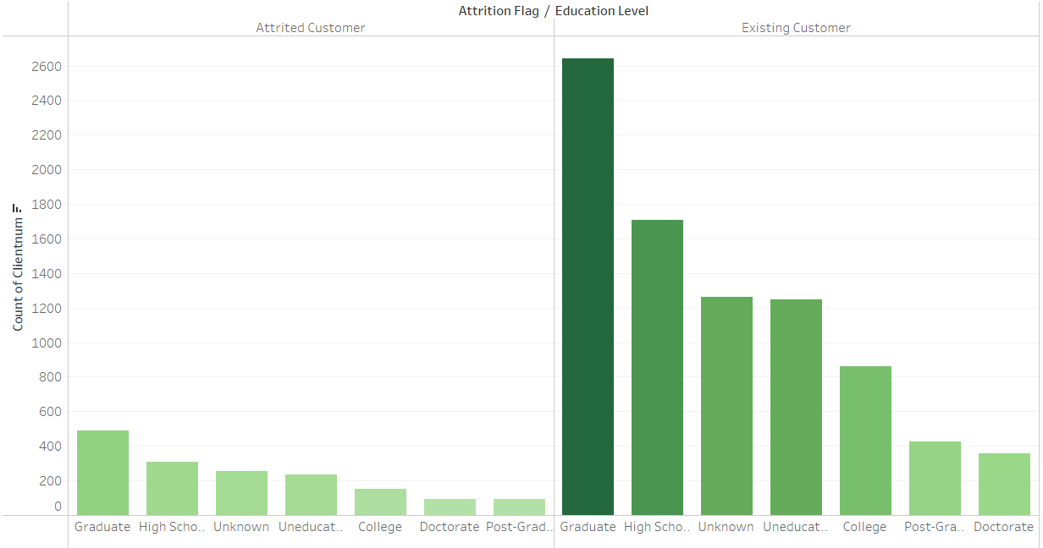
Education wise count of customers.
Most of the customers are graduated and only few of them have doctorate and PG in both category.

Slide 18
Insights
84% of customers are classified as "Existing," while 16% are categorized as "Attrited."
Both "Attrited" and "Existing" customer groups have a majority of females.
The data reveals that customer numbers are highest in England and lowest in Wales.
"Silver" cardholders make up the majority of "Existing" customers, while "Platinum" cardholders have the highest representation among "Attrited" customers.
The highest number of customers is in England.
The majority of customers are graduates, with only a few having doctorate or postgraduate degrees.
Platinum cardholders have fewer inactive months on average.
A significant number of attrited customers fall within the age group of 40 to 50.
Most customers fall into the income category of below $40,000.

Slide 19
Thank You

